Slide 1
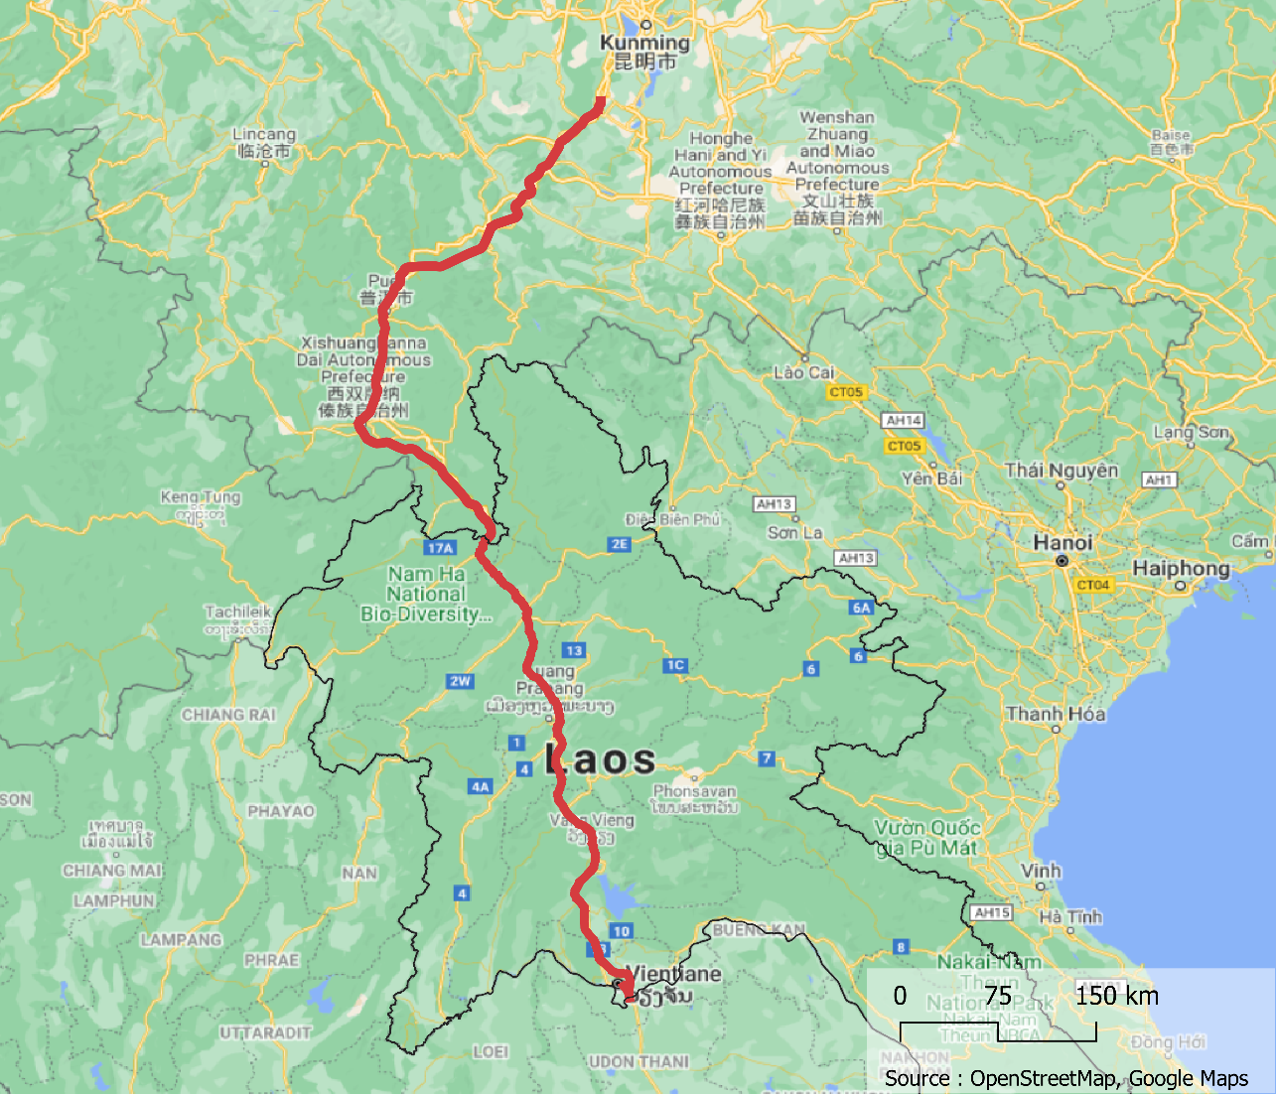
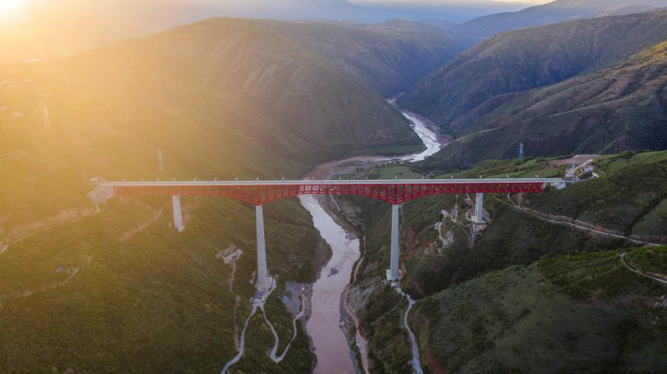
Project name : | Laos-China Railway
Sector : | Transport
Subsector : | Rail
Type : | High-speed train
Delivery date : | October 2021
Investments : | $350 million in December 2015 $1580 million in September 2016 $4170 million in October 2018 Made by China Railway Engineering
Transaction party : | none
Method of identification : | Analysis of official documents and matching press articles
This high-speed train portion in part of the Kunming-Singapore railway project, . It is the first BRI project finished and it has been operational since December 2021 and the train currently runs between Kunming and Vientianne (414 km). It is built along a BOT economic model with 50 years of exploitation and 20 years in option. The construction of this railway line was a technological challenge in view of the complexity of the mountainous Lao territory. There are no less than 75 tunnels and 167 bridges. In order to understood the difficult terrain the Chinese construction companies used Beidou Satellite System and infrared scanning technologies.
China railway 2015 annual report
China railway 2018 annual report
https://thepeoplesmap.net/project/laos-china-railway/
https://www.scmp.com/business/banking-finance/article/3002518/chinas-us7-billion-railway-link-laos-almost-half-done
http://www.news.cn/english/2021-10/12/c_1310240480.htm
http://www.news.cn/english/2021-10/12/c_1310240480.htm
https://en.wikipedia.org/wiki/Boten%E2%80%93Vientiane_railway
http://english.www.gov.cn/news/photos/2018/06/23/content_281476195482906.htm
https://www.geopoliticalmonitor.com/can-chinas-belt-and-road-open-up-landlocked-laos/
https://southeastasiaglobe.com/chinas-belt-and-road-initiative-railway-laos/Ch
Major bridge across the Yuanjiang River along the China-Laos railway in southwest China's Yunnan Province. (Xinhua/Hu Chao)
http://www.news.cn/english/2021-10/12/c_1310240480.htm

Slide 2
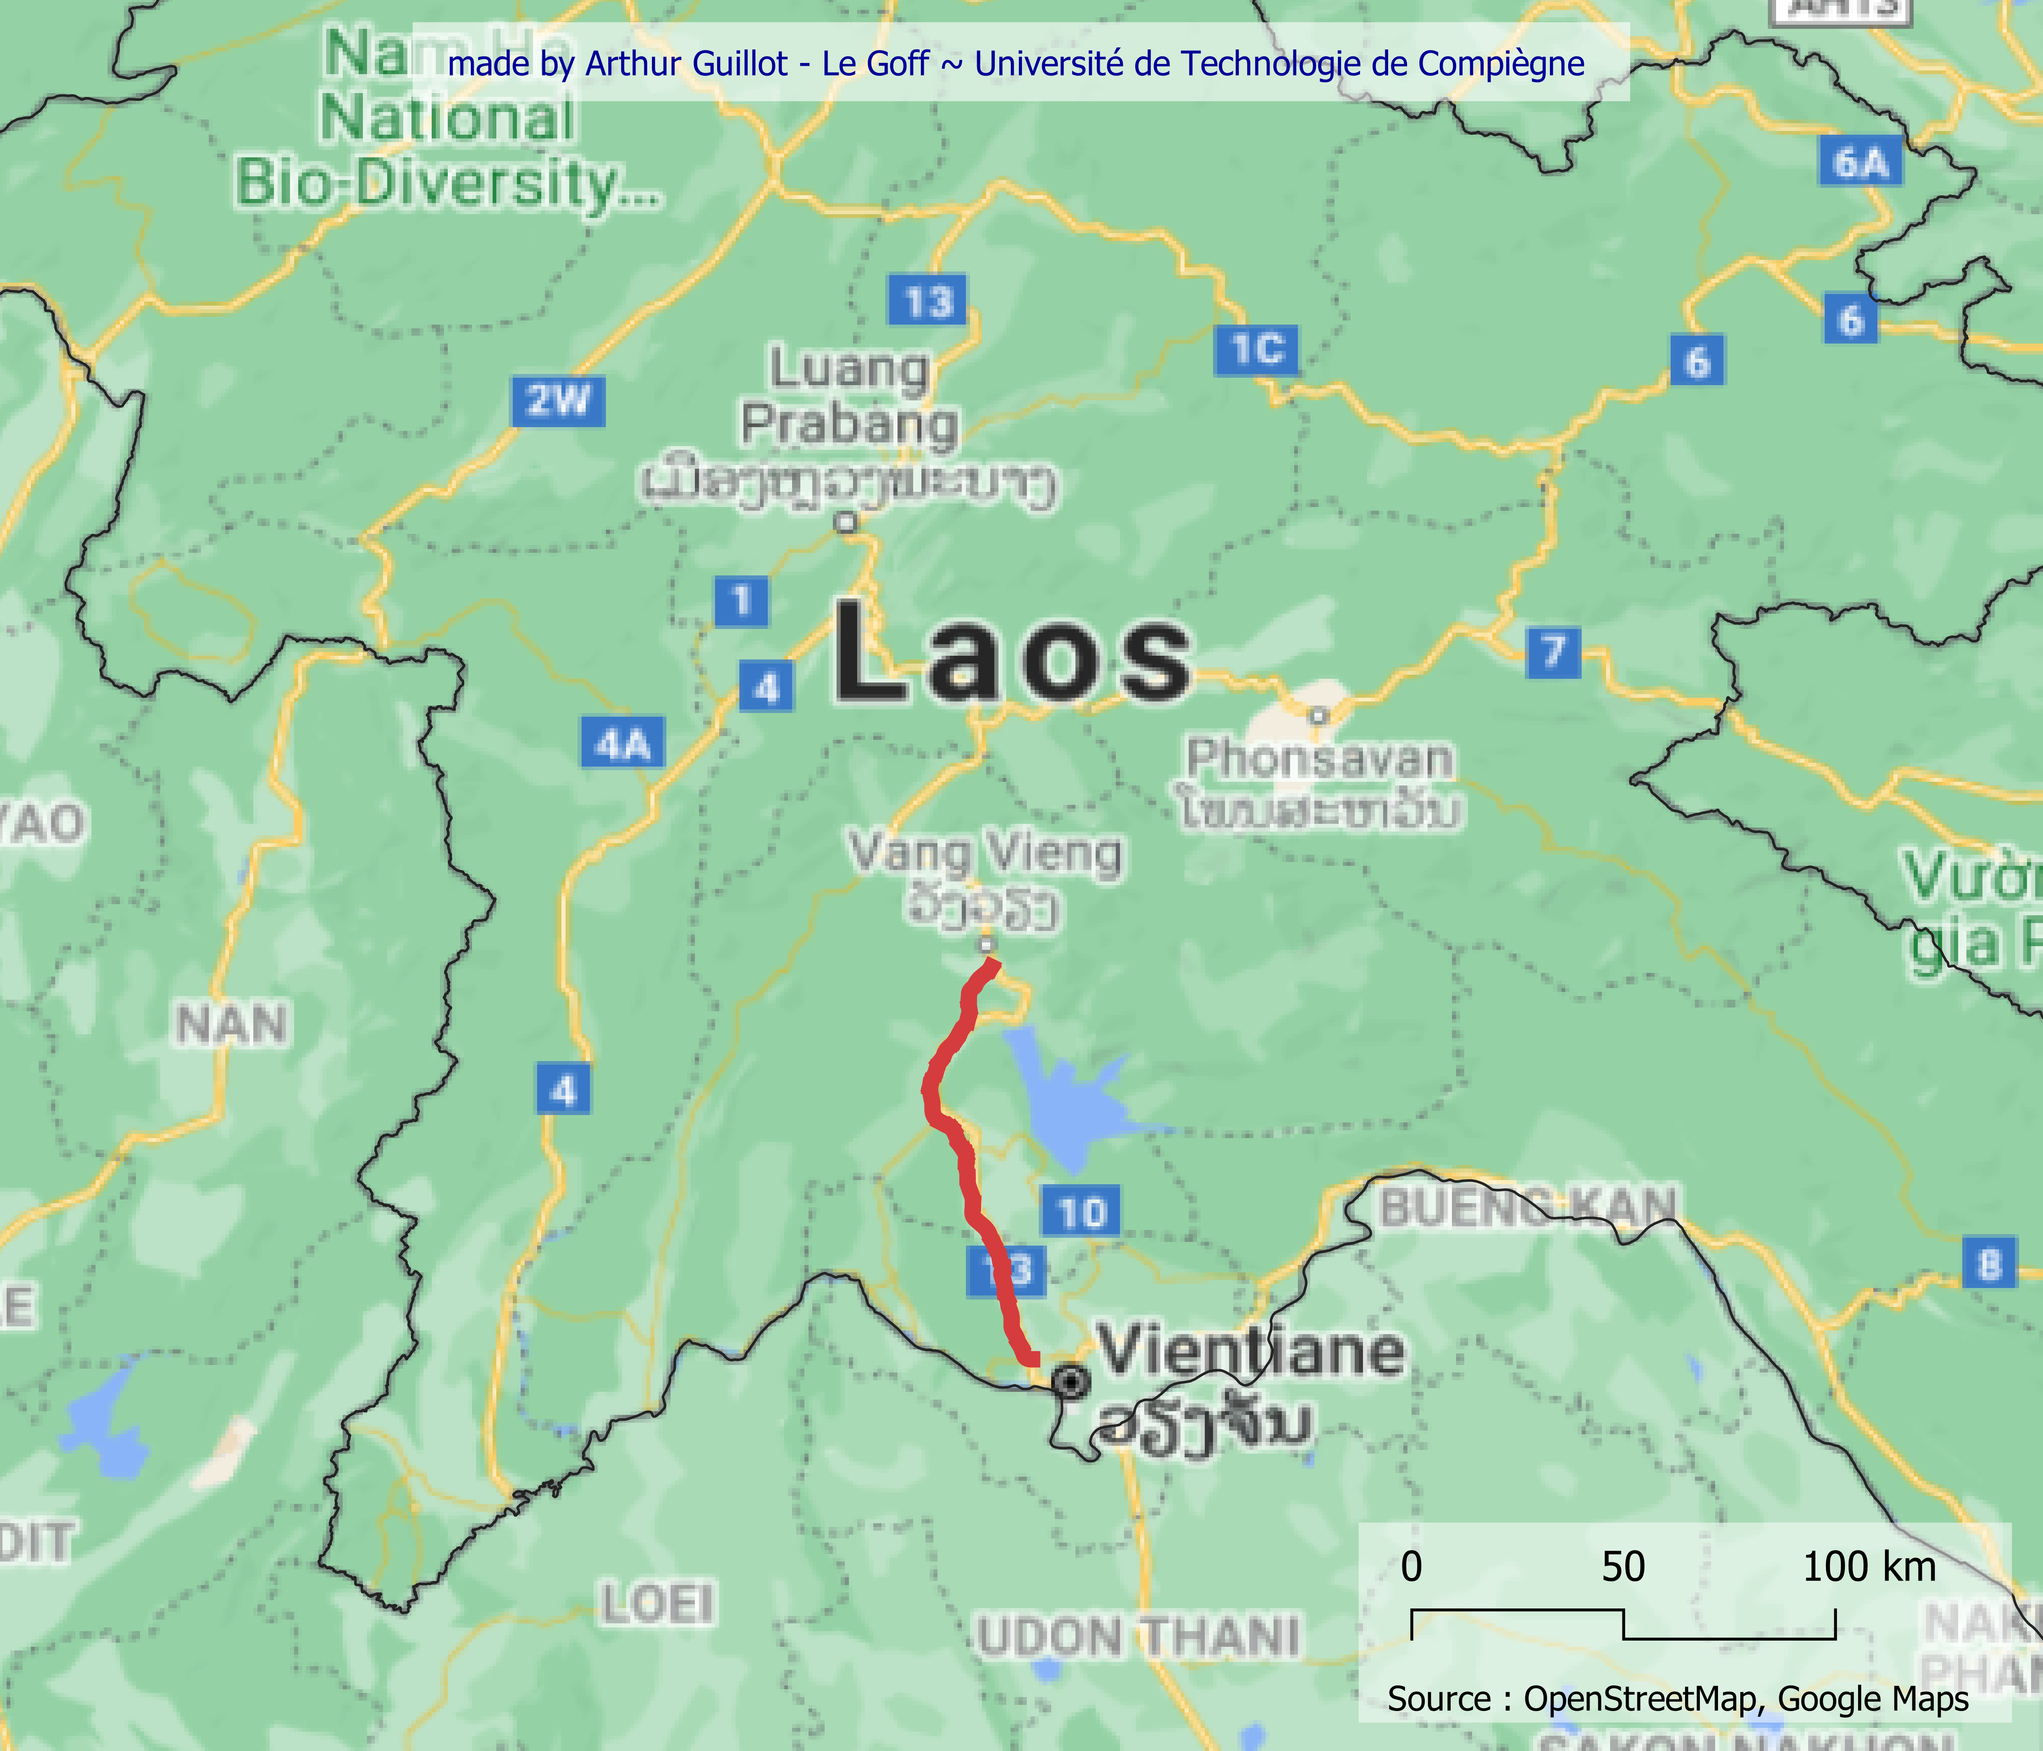
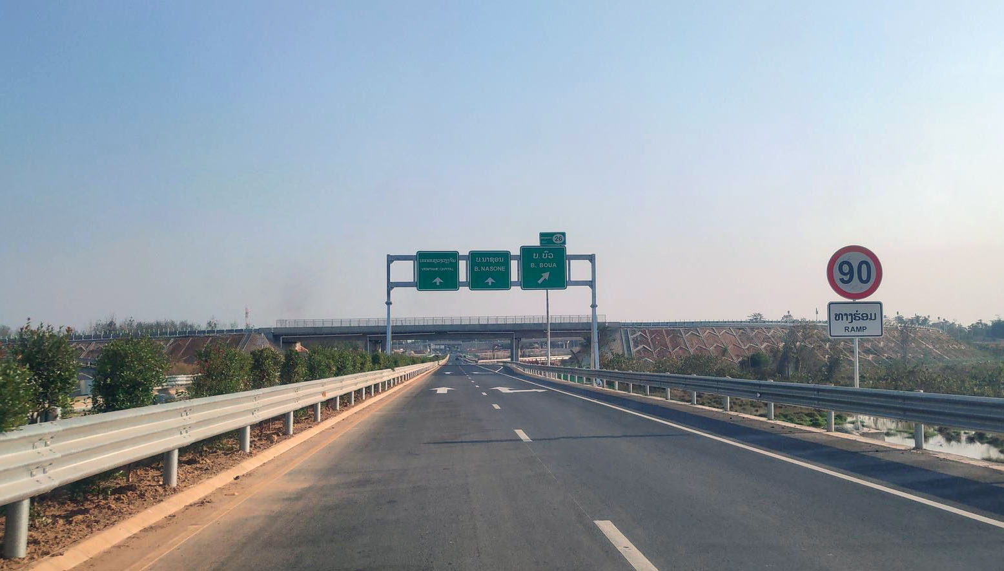
Project name : | Laos-China Highway
Sector : | Transport
Subsector : | Autos
Type : | High-speed train
Delivery date : | December 2020
Investments : | $1230 million in April 2018 Made by Yunnan Construction Engineering
Transaction party : | none
Method of identification : | Cross-referencing of press articles
This project was signed and initiated in 2018 and the first part of the highway was delivered in December 2020 (Vientiane - Vanvieng, 110km). In total the highway will be 440km long an will connect Vientiane to Boten, it will be the first express road in Laos. It is build by Yunnan Construction Engineering along a Build-Operate-Transfer (BOT) model. This means that the company receives a concession from the public sector and will maintains and operates the infrastructures. On the first section there are 36 bridges and 11 interchanges for a 2-lane road. It is notified that the constructions respect technical standards for construction and operation. In this project the Chinese company brings its expertise and its knowledge. It is build alongside the high-speed railway with the aim of promoting exchanges on the territories in the south of Yunnan.
https://www.worldhighways.com/wh10/news/new-laos-highway-connecting-key-cities
http://www.china.org.cn/world/2020-12/21/content_77033527.htm
https://www.yunnanexploration.com/china-laos-expressway.html
https://laotiantimes.com/2018/01/04/vang-vieng-expressway-extended-china/
Photo of the highway at Near Boua, Naxaithong District
By _khamla_phimmasone_US$ via Mapillary.com
https://en.wikipedia.org/wiki/Vientiane–Boten_Expressway

Slide 3
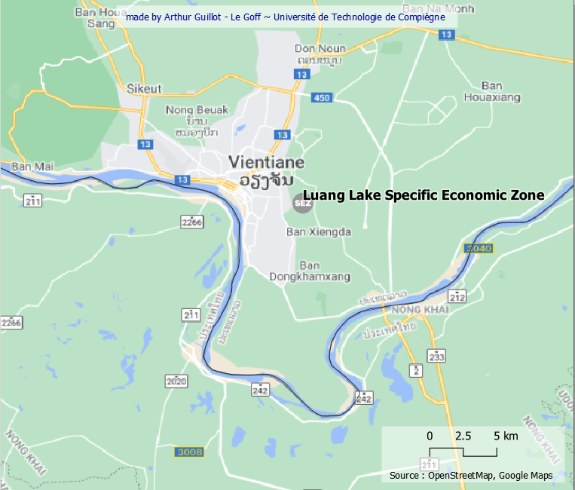
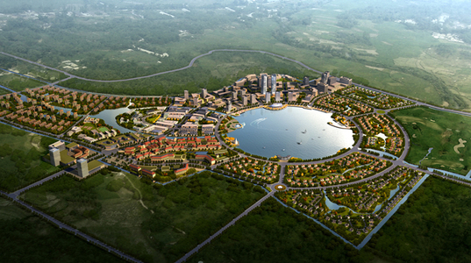
Project name : | That Luang lake Specific Economic Zone
Sector : | Real estate
Subsector : | Property
Type : | Residential & commercial
Delivery date : | Expected completion in 2030
Investments : | $520 million in January 2012 Made by Shanghai Wanfeng
Transaction party : | none
Method of identification : | Cross-referencing of press articles
This SEZ will, when fully constructed, consist of commercial, residential and tourist areas. It will eventually cover 365 hectares. The investment group Shanghai Wangeng Group is well known in China for its construction of shopping centres. In the press, one can read unclear information about the total amount of the planned investments (we can read $1600 million or $5000 million). These differences make us think that the investment will be spread out in several stages. In the end, it is a project where little information is available and at the moment only a small part of the residential buildings have been built.
https://www.thenationalnews.com/business/property/chinese-company-in-a-major-property-project-in-laos-1.454097
https://www.thailand-business-news.com/asean/laos/43574-china-increases-its-presence-in-laos.html
https://www.zawya.com/mena/en/project/160420114433/that-luang-lake-specific-economic-zone-project/
https://www.youtube.com/watch?v=6nbEv7-L6hQ
http://asiaweekly.com/turning-point/
http://en.whwanfeng.com/columns_detail/columnsId=96&FrontColumns_navigation01-1537597592576FirstColumnId=96.html
https://rentsbuy.com/2020/12/over-us100m-spent-on-that-luang-marsh-project-vientiane/
Artist’s rendition of the planned That Luang Lake SEZ or Meuang Chin. Source: http://www.investlaos.gov.la/index.php/where-to-invest/special-economic-zone?start=7

Slide 4
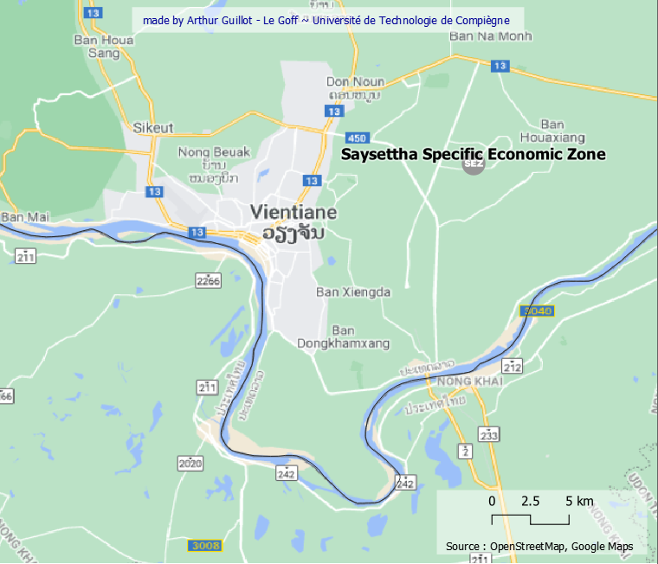
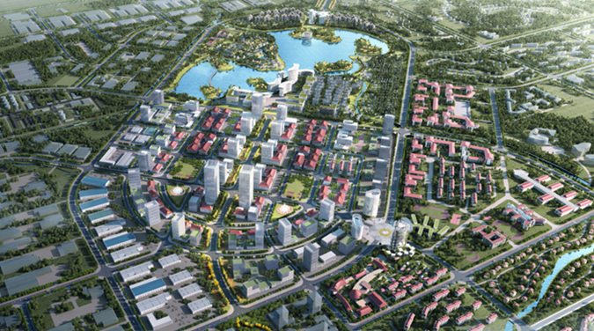
Project name : | Vientiane Saysettha Development Zone
Sector : | Real estate
Subsector : | Property
Type : | Residential & commercial & industry
Delivery date : | Expected completion in 2030
Investments : | $100 million in December 2015 Made by Yunnan Construction
Transaction party : | Saysettha Development Zone
Method of identification : | Analysis of official documents and matching press articles
The Special Economic Zone is located 14km northeast of the city centre of Vientiane. Its proximity (1.4km) to the China-Laos railway line is a major asset for the SEZ launched in November 2010. Indeed, the first phase of development is based on the reception of international companies (a first investment of 1000$ million). The second phase will then focus on logistics, trade and real estate (4000$ milion). In the long term, this area, which is far from the capital's current city centre, is seen as the future sub-centre of the city of Vientiane.
The_Comparison_of_Business_Environment_in_Developm.pdf
https://www.zawya.com/mena/en/project/210519052351/vientiane-saysettha-development-zone-project/
https://www.youtube.com/watch?v=P9pwapswiME
http://www.lvsdz.com/list/zllhtzenglishPc/9/669/auto/20/0.html
http://www.xinhuanet.com/english/2019-03/08/c_137878116.htm
http://en.yoic.cn/m/1865.html
Development Zone Master Plan
http://www.lvsdz.com/view/zllhtzenglishPc/9/548/view/35.html

Slide 5
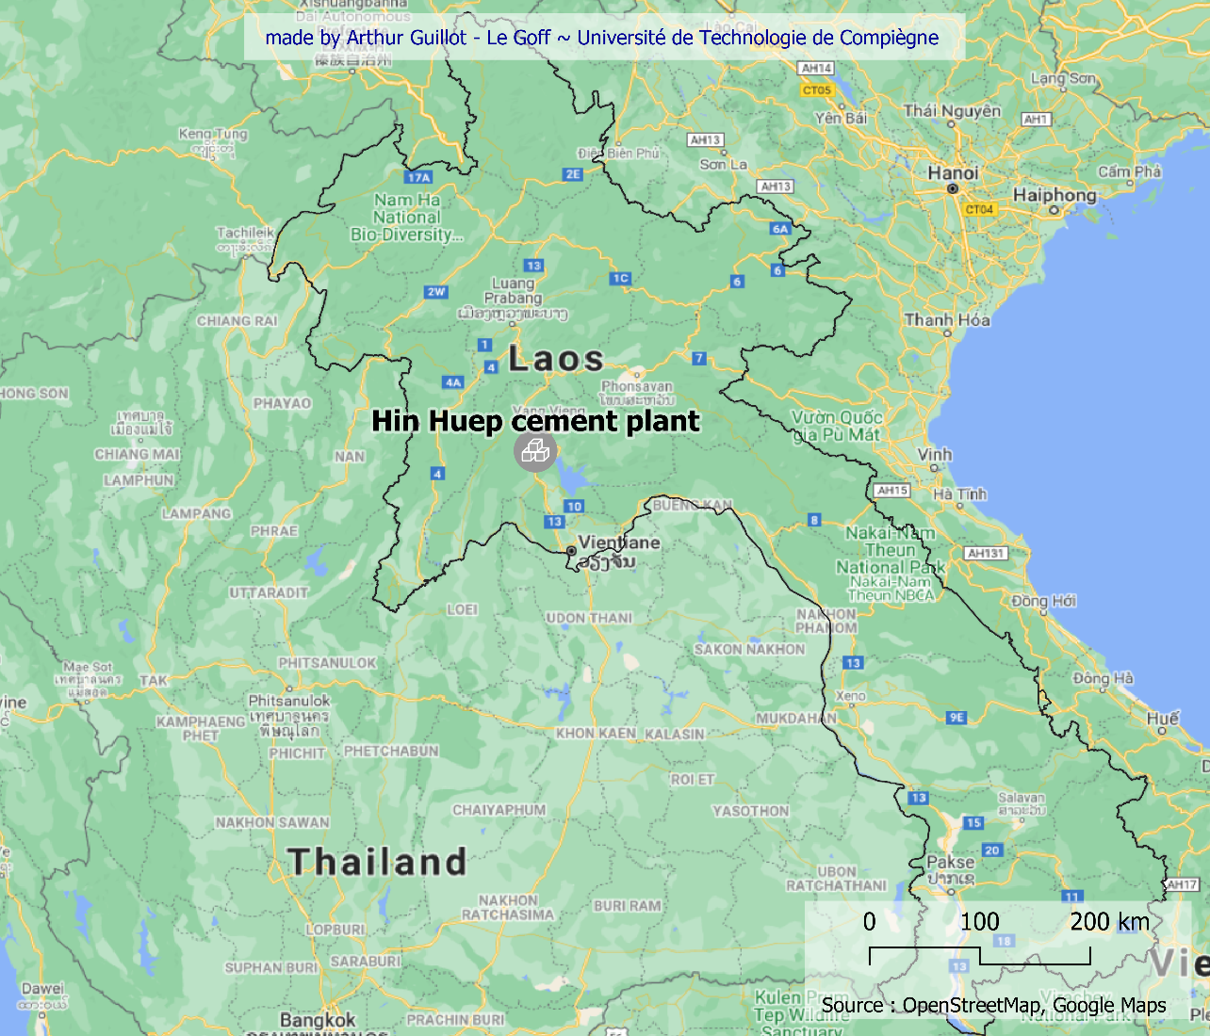
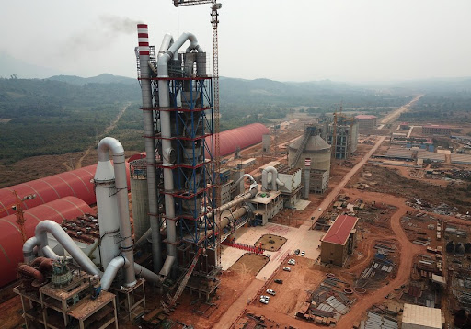
Project name : | Hin Huep cement plant
Sector : | Real estate
Subsector : | Construction
Type : | Factory
Delivery date : | 2017
Investments : | $210 million in July 2017 Made by Hongshi
Transaction party : | none
Method of identification : | Cross-referencing of press articles
We found very little information about this cement factory. Some articles report the usefulness of this factory in the construction of useful infrastructures for the inhabitants (bridges, petrol station). We could read that the factory was using "eco-friendly technologies" but we remain extremely sceptical about this information.
http://www.china.org.cn/world/Off_the_Wire/2020-10/26/content_76844066.htm
https://www.silkroadbriefing.com/news/2018/02/01/chinas-hongshi-issues-first-belt-road-bond-shanghai-laos-project/
http://www.xinhuanet.com/english/2018-02/09/c_136962518.htm
https://www.aggbusiness.com/node/132550
https://www.cemnet.com/global-cement-report/facility/hin-huep
https://en.imsilkroad.com/p/84242.html
Development Zone Master Plan
http://www.lvsdz.com/view/zllhtzenglishPc/9/548/view/35.html

Slide 6
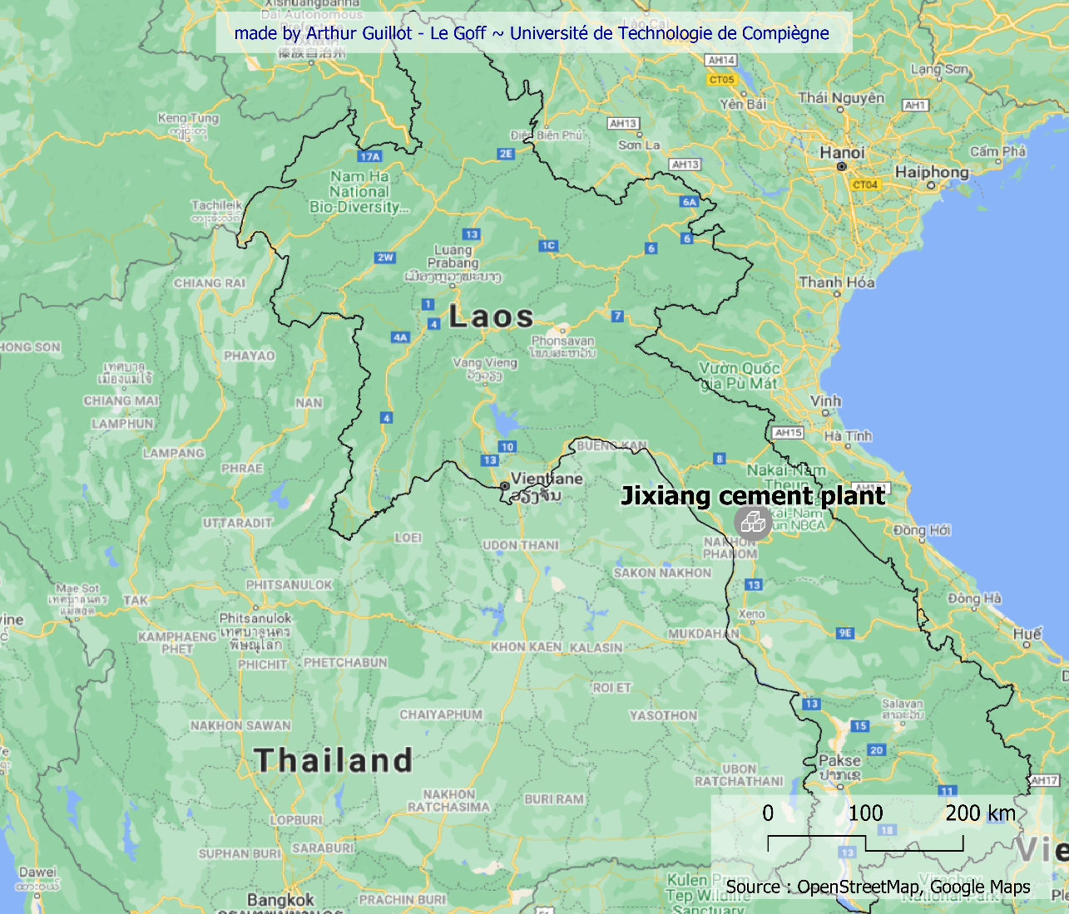
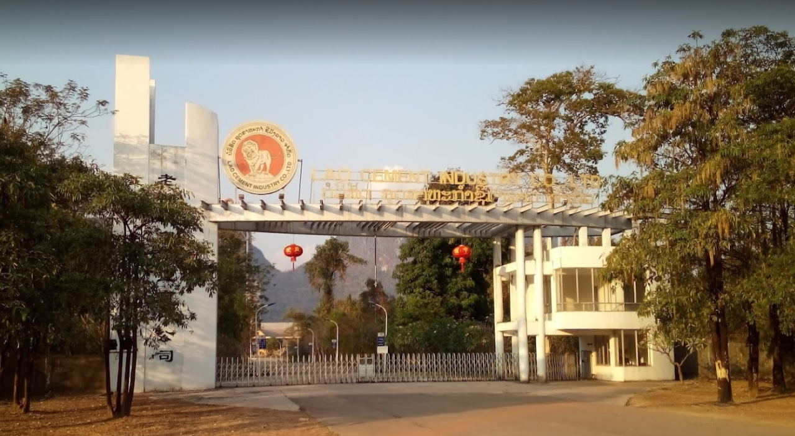
Project name : | Jixiang cement factory
Sector : | Real estate
Subsector : | Construction
Type : | Factory
Delivery date : | December 2015
Investments : | $120 million in December 2015 Made by Yunnan Energy Investment
Transaction party : | none
Method of identification : | Cross-referencing of press articles
About this cement factory, we have much more information. First, we know the overall timeline of this investment: in 2012 a contract was signed and in 2015 the project was delivered. There seems to be a confusion between the date of the investment and the date of delivery, unless the financial movement was only made at the time of delivery. Built on a BOT business model, this plant produces around 20% of Laos' cement. We also have confirmation that this project will help develop the infrastructure of the Belt and Road Initiative. The plant has produced cement for the Laos-China railway project.
www.china.org.cn/world/Off_the_Wire/2015-12/03/content_37228650.htm
https://www.theindependentbd.com/post/26215
https://www.chinadaily.com.cn/business/2015-12/04/content_22626573.htm
https://www.globaltimes.cn/content/1010645.shtml
https://www.worldcement.com/asia-pacific-rim/04122015/china-invested-cement-plant-inaugurated-laos-121/
Entry of the factory from a photo imported on google map

